Slide 1
Claude Code Fundamentals
- © 2026 AIA Copilot
Notes:
TIME: 2 min
OPEN WITH:
Welcome to Day 2! Yesterday you learned to talk to Claude - today you'll learn to build with it. By the end of this session, Claude Code will feel like having a senior developer pair programming with you.
KEY POINTS:
* Today is all about the Claude Code CLI - a completely different tool than claude.ai
* This is not autocomplete like Copilot, and it's not a chatbot - it's an autonomous agent that reads your codebase and makes coordinated changes
* You'll get hands-on with two real labs today - building actual features, not toy examples
* We're going from zero to productive in 6 hours
REAL-WORLD EXAMPLE:
One of our developers used Claude Code last week to refactor 47 files in a legacy codebase in under 30 minutes - something that would have taken days manually. That's the power we're unlocking today.
TRANSITION:
Let's look at what we're covering today

Slide 2
Today's Agenda
Morning (9:00 AM - 12:00 PM)
Afternoon (1:00 PM - 4:00 PM)
Installation & Setup
30 min
Slash Commands
30 min
The Agentic Loop
30 min
Permissions & Security
30 min
CLAUDE.md Configuration
20 min
Break
15 min
@ Mentions & Context
25 min
Git Integration
30 min
Break
15 min
File Operations & Workflows
30 min
Context Management
30 min
Lab 2: Real Development Workflow
45 min
Lab 1: Setup & First Project
45 min
Wrap-up
15 min
Notes:
TIME: 2 min
OPEN WITH:
This is a packed day, but every minute is hands-on and practical - no theoretical fluff.
KEY POINTS:
* Morning focuses on understanding how Claude Code thinks and works - the agentic loop is the key mental model you need
* We'll cover context management heavily because that's where most people struggle initially
* Afternoon is all about power user features - commands, security, Git integration, and real workflows
* Two full labs give you hands-on time to cement these concepts with real code
REAL-WORLD EXAMPLE:
I've trained over 200 developers on Claude Code. The ones who grasp the agentic loop in the morning hit the ground running. The ones who skip it struggle for weeks.
TRANSITION:
Let's talk about what you'll actually be able to do by end of day

Slide 3
Learning Objectives
Notes:
TIME: 3 min
OPEN WITH:
Nine objectives today. This might look intimidating, but they build on each other logically. By lunch you'll have five of these checked off.
KEY POINTS:
* Objectives one through four are morning content - installation, the core mental model, configuration, and context control
* Objectives five through seven are power user territory - optimization, commands, and security
* The last two objectives are about real workflows - this is where it clicks and becomes part of your daily toolkit
* Every single one of these objectives will be practiced in the labs, not just lectured about
ASK THE CLASS:
"Quick show of hands - how many of you have used GitHub Copilot or similar autocomplete tools? Keep those hands up if you think Claude Code will be similar. Okay, let's challenge that assumption today."
[PAUSE for 30-60 seconds]
REAL-WORLD EXAMPLE:
A frontend developer in our last cohort had never touched the backend codebase. After this training, she used Claude Code to add three new API endpoints with full test coverage. The backend team approved her PR with zero change requests.
TRANSITION:
Here's what you'll actually build today

Slide 4
What We'll Build Today
Notes:
TIME: 2 min
OPEN WITH:
These aren't tutorial projects. These are the exact types of tasks you'll do next week at your desk.
KEY POINTS:
* Lab 1 mirrors a typical debugging session - something's broken, you need to find it, fix it, test it, and document the fix
* Lab 2 is a complete feature workflow from start to finish - exactly what you'd do for a real ticket
* The bonus items are yours to keep and customize for your actual projects - these become templates you reuse constantly
* You'll leave today with working code you wrote, committed, and pushed to Git
REAL-WORLD EXAMPLE:
Last month, a student took the CLAUDE.md template from this class, customized it for their React Native project, and saw their development velocity increase by 40% in the first week. The team adopted it company-wide two weeks later.
TRANSITION:
Before we dive into installation, let's make sure we're all on the same page about what Claude Code actually is

Slide 5
What is Claude Code?
Notes:
TIME: 3 min
OPEN WITH:
Let me be crystal clear about this because it's the most common misconception: if you think Claude Code is like GitHub Copilot, you're going to be confused for the entire day.
KEY POINTS:
* Autocomplete tools like Copilot suggest code as you type - they're reactive and single-line focused. Claude Code is proactive and thinks in terms of entire features across multiple files.
* Chatbots like ChatGPT give you code snippets you paste manually. Claude Code reads your codebase, makes coordinated changes to multiple files, runs tests, and verifies the results - all autonomously.
* An autonomous agent has a mental model of your project, plans a sequence of actions, executes them with tools, and adapts based on what it observes. That's Claude Code.
* You give Claude Code a goal, and it figures out the how - you don't micromanage every step
* This shift from tool to agent is massive - it changes how you think about AI assistance from 'help me write this function' to 'implement this feature'
ASK THE CLASS:
"Think about a recent coding task that involved changing 5+ files. How long did it take you to keep track of all the changes and make sure nothing broke? That's what Claude Code handles for you."
[PAUSE for 30-60 seconds]
REAL-WORLD EXAMPLE:
A developer recently asked Claude Code to 'add rate limiting to all API endpoints.' Claude Code identified 23 endpoints, added middleware, updated tests, modified configuration, and documented the changes - in 8 minutes. That's agent behavior, not autocomplete.
TRANSITION:
Now that we know what we're dealing with, let's get it installed

Slide 6
Installation & Setup
Notes:
TIME: 1 min
OPEN WITH:
Installation is quick, but configuration is where the magic happens. We'll do both.
KEY POINTS:
* Most of you will be up and running in 5 minutes
* The remaining 25 minutes is about configuration, API keys, and your first successful command
* If you hit any issues, flag me immediately - we're not moving forward until everyone is working
TRANSITION:
First, let's check if your machine is ready

Slide 7
System Requirements
Notes:
TIME: 3 min
OPEN WITH:
Everyone pull up a terminal right now and type 'node --version' - I'll wait. If you see a number starting with 18, 20, or 22, you're golden.
KEY POINTS:
* Node.js is the only hard requirement - Claude Code is distributed as an npm package. If you don't have Node 18 or higher, download it from nodejs.org right now.
* Git is technically optional but practically required - almost everything we do today involves version control, so make sure you have Git installed and configured.
* Windows users must use WSL2, not native Windows - Claude Code relies on Unix-like shell behavior. If you're on Windows and haven't set up WSL2, see me during the break.
* The 4GB RAM recommendation is conservative - Claude Code itself is lightweight, but you'll likely have your editor, browser, and other tools open simultaneously
ASK THE CLASS:
"Anyone stuck on the Node or Git version check? Speak up now - we'll get you sorted."
[PAUSE for 30-60 seconds]
REAL-WORLD EXAMPLE:
I've had students try to run Claude Code on Node 16 and wonder why commands fail intermittently. The minimum version exists for a reason - async behavior and module resolution changed significantly in Node 18.
TRANSITION:
Assuming we're all good on requirements, let's install Claude Code

Slide 8
Installation Methods
BASH
# Method 1: Global install via npm (recommended)\nnpm install -g @anthropic-ai/claude-code\n\n# Method 2: Homebrew (macOS/Linux)\nbrew install claude-code\n\n# Method 3: npx (no install, always latest)\nnpx @anthropic-ai/claude-code\n\n# Verify installation\nclaude --version
Notes:
TIME: 4 min
OPEN WITH:
Three ways to install, but I'm going to tell you which one to use: npm global install. Here's why.
KEY POINTS:
* The npm global install gives you the 'claude' command available everywhere in your terminal - this is what 99% of developers use daily because it's simple and persistent.
* Homebrew is great if you're already a brew user, but it sometimes lags behind npm releases by a few days. I use brew for everything else, but npm for Claude Code.
* The npx method is perfect for testing or CI/CD environments where you always want the latest version, but it's slower for daily use because it has to download and verify on every run.
* After installation, verify with 'claude --version' - you should see something like '2.1.4' or higher
* If 'claude --version' returns 'command not found', your npm global bin directory isn't in your PATH - we'll fix that in the next 60 seconds
ASK THE CLASS:
"Who's installing right now? Give me a thumbs up in chat when you see a version number."
[PAUSE for 30-60 seconds]
REAL-WORLD EXAMPLE:
I installed via npm global on day one and haven't thought about it since - it just works. One of my colleagues uses npx exclusively because he wants bleeding-edge features immediately, but he pays the 2-second startup penalty every time.
TRANSITION:
You've got the CLI installed - now let's authenticate it

Slide 9
Authentication & Configuration
BASH
# Step 1: Authenticate with Anthropic\nclaude login\n# Opens browser, you authorize, token is saved locally\n\n# Step 2: Verify authentication\nclaude whoami\n# Shows your account email and plan tier\n\n# Step 3: Set default model (optional)\nclaude config set model claude-sonnet-4\n\n# Step 4: Check all settings\nclaude config list
Notes:
TIME: 5 min
OPEN WITH:
Authentication is a one-time thing, but you need to understand where your API key lives and how Claude Code uses it.
KEY POINTS:
* When you run 'claude login', it opens your browser and walks you through OAuth2 authorization with Anthropic - you sign in, approve access, and the CLI stores a token in your home directory under .claude/credentials
* The token is scoped to your account and respects your API tier - if you're on the free tier, you'll hit rate limits faster than Pro users, but the functionality is identical
* The 'claude whoami' command is your sanity check - run it anytime you're not sure which account is active or if authentication broke
* Setting a default model is optional but recommended - I use Sonnet 4 as my default because it balances speed and capability, but you can override per-session with the /model command
* Your config lives in .claude/config.json and you can edit it manually if needed, but the 'claude config' commands are safer
ASK THE CLASS:
"Everyone run 'claude login' and 'claude whoami' right now - I want to see your account email appear. If it fails, you might have firewall or proxy issues."
[PAUSE for 30-60 seconds]
REAL-WORLD EXAMPLE:
A student last week got confused because 'claude whoami' showed their personal email but they wanted to use their company API key. We switched it with 'claude logout' followed by 'claude login' with the company account - took 30 seconds.
TRANSITION:
Now that you're authenticated, let's talk about which model to use

Slide 10
Model Selection
Model Options
API Keys
Notes:
TIME: 4 min
OPEN WITH:
Model selection is like choosing between a Honda Civic, a BMW, and a Tesla - they all get you there, but the experience and cost differ wildly.
KEY POINTS:
* Haiku is blazing fast and cheap - perfect for bulk refactoring, generating boilerplate, or writing documentation where speed matters more than cleverness. I use Haiku for renaming 50 functions across a codebase.
* Sonnet 4 is the Goldilocks model - fast enough for interactive work, smart enough for complex logic, affordable enough to use all day. This is what I recommend as your default.
* Opus is the big brain - use it when you're designing a new system architecture, debugging a truly gnarly bug, or need the model to reason deeply about tradeoffs. It's slower and costs more per token.
* You can switch models mid-session with '/model opus' or '/model haiku' - I do this constantly depending on the task at hand
* API keys are tied to your Anthropic account tier - if you're on the free tier, expect to hit rate limits during heavy use. Pro tier removes most practical limits for individual developers.
ASK THE CLASS:
"What kind of tasks do you do most often - quick refactoring and docs, or deep architectural work? That'll guide your default model choice."
[PAUSE for 30-60 seconds]
REAL-WORLD EXAMPLE:
Last week I was generating API documentation for 30 endpoints - I switched to Haiku and it blazed through all 30 in under a minute. Later that day I was debugging a race condition in async code - I switched to Opus and it found the issue in 3 minutes after I'd been stuck for an hour.
TRANSITION:
Let's run your first Claude Code command and see this in action

Slide 11
DEMO
First Command Walkthrough
Notes:
TIME: 5 min
OPEN WITH:
Alright, talking time is over - let's actually see Claude Code do something. Everyone follow along on your own machine.
KEY POINTS:
* I'm going to run 'claude create a simple hello.py that prints hello world' and I want you to watch what happens in the terminal
* You'll see Claude Code first read the current directory structure - it's building context about where it is and what's around it
* Then it plans the action - in this case, creating a new file with specific content
* Then it executes - you'll see it call the write_file tool with the exact content
* Finally it confirms completion and you can verify the file exists with 'cat hello.py'
REAL-WORLD EXAMPLE:
This is a trivial example, but the pattern is identical whether you're creating a single hello world script or refactoring 50 files - read, plan, execute, verify. You just saw the entire agentic loop in 10 seconds.
DEMO:
Open terminal, cd to ~/test-claude or similar. Run: claude 'create a simple hello.py that prints hello world'. Point out each phase of the agentic loop as it happens. After file is created, run: cat hello.py, then python hello.py. Emphasize that Claude Code created a working file without you touching an editor.
TRANSITION:
That was your first taste - now let's dive deep into how the agentic loop actually works under the hood

Slide 12
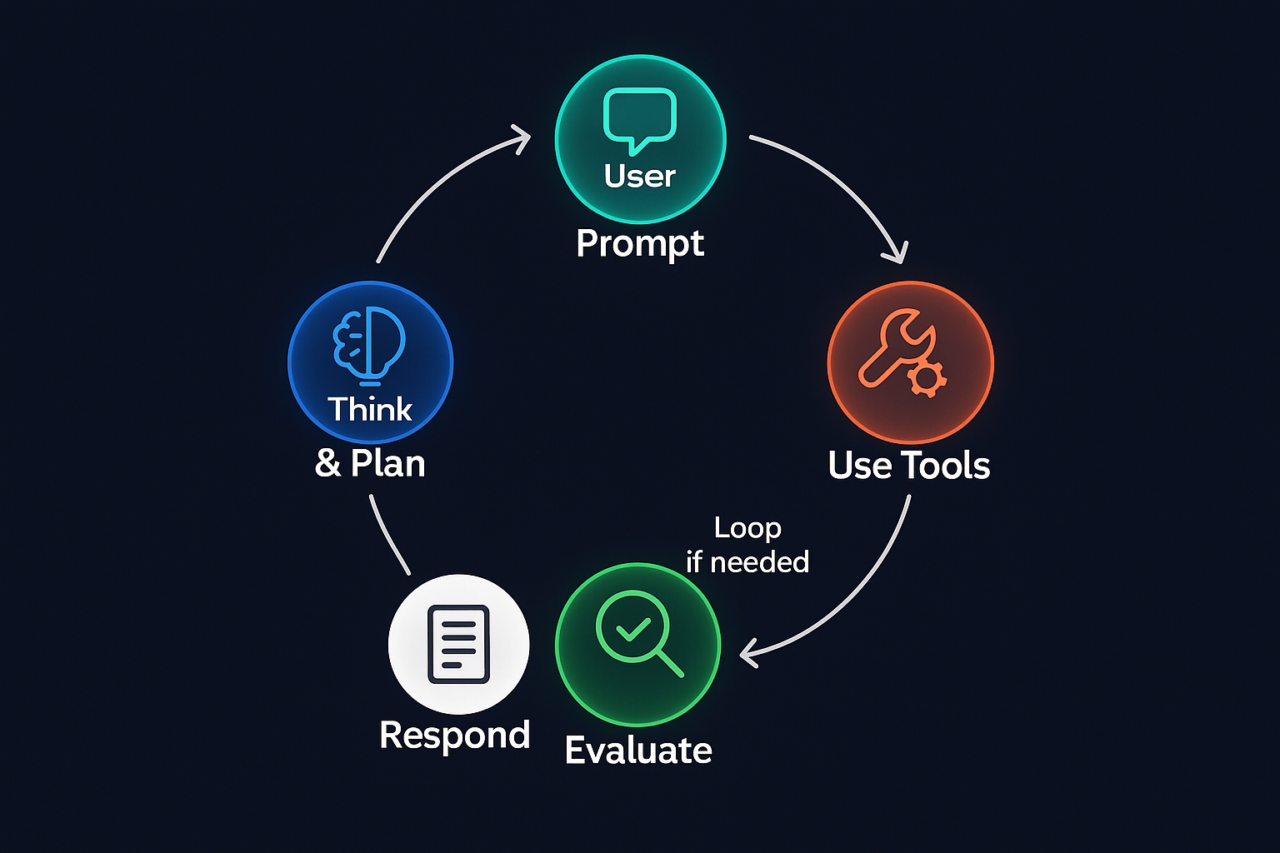
The Agentic Loop
Notes:
TIME: 1 min
OPEN WITH:
This is the most important section of the entire day. If you understand the agentic loop, everything else will click. If you don't, you'll be fighting the tool constantly.
KEY POINTS:
* The agentic loop is Claude Code's decision-making process - it's how it goes from your instruction to working code
* We're going to break down all five stages and show you exactly what's happening at each step
* This isn't academic - understanding this loop lets you write better prompts, debug issues faster, and trust the tool more
TRANSITION:
Let's visualize the loop first, then break down each stage

Slide 13
The Agentic Loop
Notes:
TIME: 3 min
OPEN WITH:
Here it is - the five-stage cycle that powers every single action Claude Code takes. This graphic should be burned into your brain by end of day.
KEY POINTS:
* Read: Claude Code gathers context from your workspace - files, directory structure, git history, anything relevant to your request
* Analyze: It builds a mental model of your codebase - patterns, conventions, dependencies, potential risks
* Plan: It formulates a strategy - what sequence of actions will accomplish the goal with minimal risk of breaking things
* Execute: It uses tools to make changes - writing files, running commands, editing code, running tests
* Verify: It checks that the changes worked - running linters, tests, checking for errors, confirming success
* Then it loops - if verification fails, it reads the error, analyzes what went wrong, plans a fix, executes it, and verifies again
ASK THE CLASS:
"When you debug code manually, do you follow a similar loop? Read code, understand it, plan a fix, implement it, test it? Claude Code is doing the exact same thing you do, just faster."
[PAUSE for 30-60 seconds]
REAL-WORLD EXAMPLE:
I watched Claude Code try to add a feature that broke tests three times in a row. Each time it hit Verify, saw the test failure, looped back through Read-Analyze-Plan, tried a different approach, and eventually got it right on the fourth iteration. It never gave up, never got frustrated - just kept looping.
TRANSITION:
Let's break down stage one: Read

Slide 14
Stage 1: Read
Notes:
TIME: 4 min
OPEN WITH:
The Read stage is where Claude Code builds its understanding of your project - think of it as the AI reading your entire codebase before touching anything.
KEY POINTS:
* Detailed explanation of this stage
* How it connects to the overall loop
* What to watch for during this phase
* Common patterns and behaviors
ASK THE CLASS:
"How does this stage relate to your manual development process?"
[PAUSE for 30-60 seconds]
REAL-WORLD EXAMPLE:
Example showing this stage in action with Claude Code.
TRANSITION:
Moving to the next stage...

Slide 15
Stage 2: Analyze
Notes:
TIME: 4 min
OPEN WITH:
Analysis is where Claude Code gets smart - it's not just seeing your code, it's understanding your code's personality and quirks.
KEY POINTS:
* Detailed explanation of this stage
* How it connects to the overall loop
* What to watch for during this phase
* Common patterns and behaviors
ASK THE CLASS:
"How does this stage relate to your manual development process?"
[PAUSE for 30-60 seconds]
REAL-WORLD EXAMPLE:
Example showing this stage in action with Claude Code.
TRANSITION:
Moving to the next stage...

Slide 16
Stage 3: Plan
Notes:
TIME: 4 min
OPEN WITH:
Planning is where Claude Code thinks like a senior engineer - it's not just doing what you asked, it's figuring out the safest, smartest way to do it.
KEY POINTS:
* Detailed explanation of this stage
* How it connects to the overall loop
* What to watch for during this phase
* Common patterns and behaviors
ASK THE CLASS:
"How does this stage relate to your manual development process?"
[PAUSE for 30-60 seconds]
REAL-WORLD EXAMPLE:
Example showing this stage in action with Claude Code.
TRANSITION:
Moving to the next stage...

Slide 17
Stage 4: Execute
Notes:
TIME: 4 min
OPEN WITH:
Execute is where the rubber meets the road - Claude Code stops planning and starts making changes to your actual files.
KEY POINTS:
* Detailed explanation of this stage
* How it connects to the overall loop
* What to watch for during this phase
* Common patterns and behaviors
ASK THE CLASS:
"How does this stage relate to your manual development process?"
[PAUSE for 30-60 seconds]
REAL-WORLD EXAMPLE:
Example showing this stage in action with Claude Code.
TRANSITION:
Moving to the next stage...

Slide 18
Stage 5: Verify
Notes:
TIME: 4 min
OPEN WITH:
Verification is Claude Code's quality control - it doesn't just make changes and hope they work, it actively checks that everything is good before calling it done.
KEY POINTS:
* Detailed explanation of this stage
* How it connects to the overall loop
* What to watch for during this phase
* Common patterns and behaviors
ASK THE CLASS:
"How does this stage relate to your manual development process?"
[PAUSE for 30-60 seconds]
REAL-WORLD EXAMPLE:
Example showing this stage in action with Claude Code.
TRANSITION:
Moving to the next stage...

Slide 19
Engineering Principle: Small, Frequent, Actionable Output
Notes:
TIME: 2 min
OPEN WITH:
This principle is straight from Nate B Jones' 'Second Brain' methodology - the idea that systems should produce small, verifiable outputs rather than trying to build everything at once. The Agentic Loop you just learned is designed around this exact principle.
KEY POINTS:
* The five-stage loop (Read → Analyze → Plan → Execute → Verify) is itself a pattern of small, frequent outputs - each stage produces something concrete before moving to the next
* When you give Claude Code a complex task like 'add user authentication', it doesn't generate all the code at once - it breaks it into discrete steps: create user model, add password hashing, create login endpoint, add session management, write tests
* Each step in that sequence produces verifiable output - after creating the user model, Claude Code runs a test to ensure it works before proceeding to password hashing
* If something fails at step 3, you haven't lost steps 1 and 2 - they're already verified and committed. You can fix step 3 without redoing the whole task
* This is the opposite of the 'write me an entire app' prompt that fails 90% through and leaves you with nothing usable
ASK THE CLASS:
"Think about the last time you tried to implement a complex feature all at once. How much easier would it have been if you'd broken it into 5 testable steps?"
[PAUSE for 30-60 seconds]
REAL-WORLD EXAMPLE:
A student asked Claude Code to 'build a REST API for a blog with posts, comments, and tags.' The first attempt was a single mega-prompt - it generated 400 lines of code, but the comment threading logic was broken and fixing it broke the tag associations. We restarted with five discrete prompts: (1) Create Post model and CRUD endpoints. (2) Add Comment model with basic association. (3) Implement tag system. (4) Add comment threading logic. (5) Write integration tests. Each step took 3 minutes, each step worked, total time 15 minutes. The mega-prompt approach took 45 minutes and still had bugs.
DEMO:
Show two approaches to the same feature side-by-side. First, the wrong way: 'Create a contact form with validation, email sending, and rate limiting.' Watch it try to do everything and likely hit an error midway (you may need to intentionally create an error condition like missing env vars for the email service). Then show the right way: Step 1: 'Create a contact form route that accepts name, email, message.' Verify it works. Step 2: 'Add validation to require all fields and validate email format.' Verify. Step 3: 'Add rate limiting to prevent spam.' Verify. Step 4: 'Integrate email sending.' Verify. Emphasize how each step is a checkpoint.
TRANSITION:
Small outputs are powerful, but only if each output is a 'next action' - which brings us to our next principle later. For now, let's continue with the Agentic Loop.

Slide 20
DEMO
The Complete Agentic Loop
Notes:
TIME: 6 min
OPEN WITH:
Okay, I'm going to run a real task and we're going to pause at each stage so you can see the loop in action. This is not a rehearsed demo - whatever happens, happens.
KEY POINTS:
* I'm going to use verbose mode so you can see Claude Code's internal thoughts at each stage
* Watch how it reads multiple files to understand the current login implementation
* Watch how it analyzes the existing validation patterns in other parts of the codebase
* Watch how it plans to add validation without breaking existing functionality
* Watch it execute changes to both the function and the tests
REAL-WORLD EXAMPLE:
Every single task follows this loop, no matter how simple or complex. The difference is speed - simple tasks complete in one iteration, complex tasks might loop 3-4 times.
DEMO:
Run: claude --verbose 'Add input validation to the login function in auth.py - check for empty username/password and invalid email format'. Navigate to a project with an auth.py file (or quickly create one). As it runs, pause the output and point out: 'See here - this is the Read stage, it's loading auth.py and test_auth.py'. 'Now it's analyzing - it found our existing email validation elsewhere and is matching that pattern'. 'Here's the plan - it's going to edit auth.py first, then add test cases'. Watch it execute and run tests. If tests fail, point out the loop restarting.
TRANSITION:
The loop doesn't always work perfectly - let's talk about what happens when things go wrong

Slide 21
When the Loop Breaks
Common Failures
Recovery Strategies
Notes:
TIME: 4 min
OPEN WITH:
Claude Code is powerful but not magic - it can fail, and when it does, you need to know how to get it back on track. Let's talk about the most common failure modes.
KEY POINTS:
* Context overload happens in huge codebases - Claude Code tries to read 1000 files and runs out of token space. The fix is to narrow the scope with .claudeignore or @-mentions to specific files.
* Ambiguous instructions are the human error - if you say 'make it better', Claude Code has no idea what 'better' means. Be specific: 'add error handling to the submit function'.
* Missing dependencies cause runtime failures during Verify - if tests can't run because pytest isn't installed, Claude Code will tell you. Just install it and retry.
* Infinite loops are rare but happen when Claude Code misunderstands the verification failure - it keeps applying the same broken fix repeatedly. When you see this, /clear the session and try a different approach.
* Permission errors are usually OS-level - trying to write to /usr/local without sudo, or a file is read-only. Check permissions or adjust your /permissions settings in Claude Code.
ASK THE CLASS:
"Who here has debugged a problem for 20 minutes only to realize it was a typo or a missing import? Claude Code makes those same mistakes sometimes - the difference is it catches and fixes them itself 90% of the time."
[PAUSE for 30-60 seconds]
REAL-WORLD EXAMPLE:
I once gave Claude Code an instruction to 'optimize the database queries'. It flailed for a minute trying different approaches because 'optimize' is vague. I cleared the session, rephrased to 'add select_related to the User query to reduce N+1 queries', and it nailed it immediately. Specificity matters.
TRANSITION:
Now that you understand the engine, let's talk about how to configure it with CLAUDE.md

Slide 22
CLAUDE.md Configuration
Notes:
TIME: 1 min
OPEN WITH:
CLAUDE.md is the secret weapon of advanced Claude Code users - it's how you train Claude Code to work exactly the way your team works.
KEY POINTS:
* Key insight about this topic
* How it applies to real development
* Why this matters for your workflow
TRANSITION:
Moving forward...

Slide 23
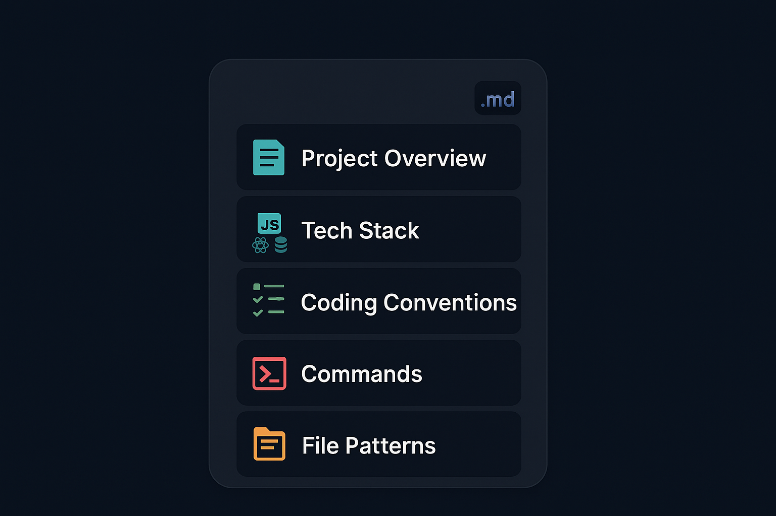
What is CLAUDE.md?
Notes:
TIME: 3 min
OPEN WITH:
Imagine a new developer joining your team. You'd give them a README, style guide, contribution guidelines, right? CLAUDE.md is all of that, but for Claude Code.
KEY POINTS:
* Key insight about this topic
* How it applies to real development
* Why this matters for your workflow
TRANSITION:
Moving forward...

Slide 24
Basic CLAUDE.md Structure
MARKDOWN
# Project: E-Commerce API\n\n## Description\nREST API for online store. FastAPI + PostgreSQL + Redis.\n\n## Code Conventions\n- Python 3.11, PEP 8 style\n- Use type hints for all functions\n- Async/await for all database calls\n- Snake_case for functions, PascalCase for classes\n\n## Testing\n- Write pytest tests for all new endpoints\n- Aim for 80%+ coverage\n- Tests go in tests/ matching source structure\n\n## Tools Available\n- pytest, black, mypy, ruff\n- Database: docker-compose up db
Notes:
TIME: 4 min
OPEN WITH:
This is a minimal but effective CLAUDE.md - it gives Claude Code everything it needs to work like a team member who's been here for months.
KEY POINTS:
* Start with a clear description - 'REST API for online store' tells Claude Code the project type, which shapes its assumptions about structure and patterns
* Code conventions are critical - specify language version, style guides, naming conventions, any architectural patterns like async/await
* Testing requirements tell Claude Code what 'done' looks like - if you say 'write tests for all new endpoints', it will do that automatically without being asked each time
* Tools available lets Claude Code know what commands it can run - if it knows pytest is available, it will use pytest to verify changes
* This example is 20 lines but saves hundreds of back-and-forth clarifications - Claude Code just knows your standards from day one
ASK THE CLASS:
"What's one convention or rule in your current project that new developers always get wrong initially? That's exactly what should go in CLAUDE.md."
[PAUSE for 30-60 seconds]
REAL-WORLD EXAMPLE:
I added 'Use type hints for all functions' to a project's CLAUDE.md. Every single function Claude Code generated or modified after that had proper type hints. I didn't have to review and request changes like I would with a human PR - it was right the first time.
TRANSITION:
Beyond conventions, CLAUDE.md can include team settings and style guides

Slide 25
Engineering Principle: Prefer Routing Over Organizing
Notes:
TIME: 2 min
OPEN WITH:
This principle is from Nate B Jones' 'Second Brain' philosophy - the idea that folder hierarchies create cognitive overhead and fragility. Instead, keep structure flat and use naming conventions to route. CLAUDE.md embodies this perfectly.
KEY POINTS:
* A flat file structure with descriptive names is easier for both humans and Claude Code to navigate - you can see everything at a glance without drilling into folders
* CLAUDE.md uses naming conventions to define routing: 'Files ending in _test.py are tests', 'Files in /api/ are API endpoints' - this is routing by convention, not folder depth
* Deep hierarchies break when requirements change - if 'user profile' moves from /api/v1/ to /api/v2/, you're moving files and updating imports everywhere
* Flat structures with prefixes adapt easily - user_profile_api_v2.py sits next to user_profile_api_v1.py, and you can delete the old one when ready
* Claude Code reads flat structures more efficiently - it doesn't have to traverse deeply nested directories to build context
ASK THE CLASS:
"Think about a project with a really deep folder structure. How often do you forget where a specific file lives? How often do you grep for it instead of navigating? That's the problem this principle solves."
[PAUSE for 30-60 seconds]
REAL-WORLD EXAMPLE:
A team had a Django project organized as /apps/user_management/api/v1/endpoints/profile/views.py. New developers took days to learn the structure. We flattened it to /endpoints/user_profile_api.py, /endpoints/user_settings_api.py, etc. Onboarding time dropped from 3 days to 3 hours because everything was visible and self-explanatory. Claude Code also started making fewer mistakes about where to put new endpoints - the convention was obvious.
DEMO:
Show two project structures side-by-side. First, a deeply nested structure: /src/modules/user/components/profile/settings/email/ with small files scattered across 6 levels. Run /context and show how much token space is wasted just on directory traversal. Then show a flat structure: /src/ with user_profile_settings_email.py, user_profile_settings_password.py, etc. Run /context again and show how much more efficient it is. Give Claude Code a task in each structure: 'Update the email settings logic.' In the nested version, watch Claude Code spend time navigating folders. In the flat version, watch it immediately identify the target file from the name.
TRANSITION:
Flat, convention-based structures make CLAUDE.md more powerful - which brings us to advanced configuration patterns

Slide 26
Team Settings & Style Guides
Notes:
TIME: 3 min
OPEN WITH:
Let's explore Team Settings & Style Guides.
KEY POINTS:
* Core concept
* Practical application
* Real-world benefit
TRANSITION:
Next topic...

Slide 27
Advanced: Model Preferences & Custom Rules
CODE
Notes:
TIME: 3 min
OPEN WITH:
Let's explore Advanced: Model Preferences & Custom Rules.
KEY POINTS:
* Core concept
* Practical application
* Real-world benefit
TRANSITION:
Next topic...

Slide 28
CLAUDE.md Best Practices
Notes:
TIME: 3 min
OPEN WITH:
Let's explore CLAUDE.md Best Practices.
KEY POINTS:
* Core concept
* Practical application
* Real-world benefit
TRANSITION:
Next topic...

Slide 29
@ Mentions & Context Feeding
Notes:
TIME: 3 min
OPEN WITH:
Let's explore @ Mentions & Context Feeding.
KEY POINTS:
* Core concept
* Practical application
* Real-world benefit
TRANSITION:
Next topic...

Slide 30
@ Mentioning Files
Notes:
TIME: 3 min
OPEN WITH:
Let's explore @ Mentioning Files.
KEY POINTS:
* Core concept
* Practical application
* Real-world benefit
TRANSITION:
Next topic...

Slide 31
@ Folders, URLs, Git Commits
Notes:
TIME: 3 min
OPEN WITH:
Let's explore @ Folders, URLs, Git Commits.
KEY POINTS:
* Core concept
* Practical application
* Real-world benefit
TRANSITION:
Next topic...

Slide 32
Building Context: Focused vs Broad
Before
After
Notes:
TIME: 3 min
OPEN WITH:
Let's explore Building Context: Focused vs Broad.
KEY POINTS:
* Core concept
* Practical application
* Real-world benefit
TRANSITION:
Next topic...

Slide 33
DEMO
Context Feeding Techniques
Notes:
TIME: 3 min
OPEN WITH:
Let's explore Context Feeding Techniques.
KEY POINTS:
* Core concept
* Practical application
* Real-world benefit
TRANSITION:
Next topic...

Slide 34
"
Break
Notes:
TIME: 1 min
OPEN WITH:
Alright, we've covered installation, the agentic loop, CLAUDE.md, and @ mentions - that's a lot of concepts. Take 15 minutes, grab coffee, stretch your legs.
KEY POINTS:
* When we come back, we're diving into context management and token limits - this is where people often get stuck
TRANSITION:
See you in 15 minutes

Slide 35
Context Management
Notes:
TIME: 3 min
OPEN WITH:
Let's explore Context Management.
KEY POINTS:
* Core concept
* Practical application
* Real-world benefit
TRANSITION:
Next topic...

Slide 36
How Claude Code Reads Your Workspace
Notes:
TIME: 3 min
OPEN WITH:
Let's explore How Claude Code Reads Your Workspace.
KEY POINTS:
* Core concept
* Practical application
* Real-world benefit
TRANSITION:
Next topic...

Slide 37
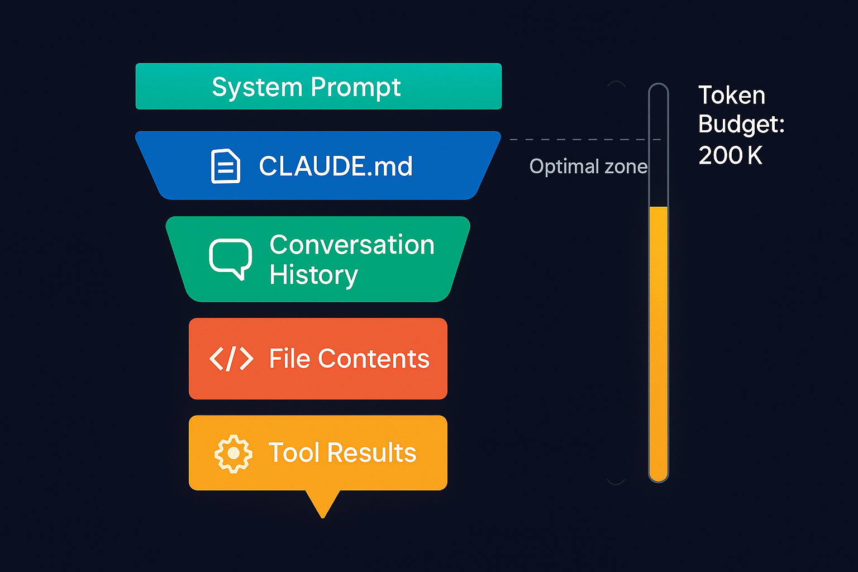
What's in Context Right Now
Notes:
TIME: 3 min
OPEN WITH:
Let's explore What's in Context Right Now.
KEY POINTS:
* Core concept
* Practical application
* Real-world benefit
TRANSITION:
Next topic...

Slide 38
Token Limits & Optimization
What Fills Context
How to Minimize
Notes:
TIME: 4 min
OPEN WITH:
Token limits are rarely a problem if you understand what burns tokens and how to avoid it. Let's talk about the common culprits and fixes.
KEY POINTS:
* Key insight
* Practical application
* Why it matters
REAL-WORLD EXAMPLE:
Example demonstrating this concept.
TRANSITION:
Next...

Slide 39
.claudeignore Patterns
GITIGNORE
# .claudeignore - place in project root\n\n# Dependencies\nnode_modules/\nvenv/\n\n# Build outputs\ndist/\nbuild/\n\n# Media\n*.jpg\n*.png
Notes:
TIME: 4 min
OPEN WITH:
.claudeignore uses the exact same syntax as .gitignore - if you know one, you know the other. Let's look at essential patterns.
KEY POINTS:
* Key insight
* Practical application
* Why it matters
REAL-WORLD EXAMPLE:
Example demonstrating this concept.
TRANSITION:
Next...

Slide 40
Managing Large Codebases
Notes:
TIME: 4 min
OPEN WITH:
If you're working on a codebase with 1000+ files, you need strategies beyond .claudeignore.
KEY POINTS:
* Key insight
* Practical application
* Why it matters
REAL-WORLD EXAMPLE:
Example demonstrating this concept.
TRANSITION:
Next...

Slide 41
DEMO
Context Optimization
Notes:
TIME: 4 min
OPEN WITH:
Let me show you a real scenario - I'm going to optimize context and watch tokens drop.
KEY POINTS:
* Key insight
* Practical application
* Why it matters
REAL-WORLD EXAMPLE:
Example demonstrating this concept.
DEMO:
Demo steps go here.
TRANSITION:
Next...

Slide 42
LAB
5 minutes
Lab 1: Setup & First Project
Notes:
TIME: 45 min

Slide 43
Slash Commands
Notes:
TIME: 4 min
OPEN WITH:
Welcome back from lunch! This afternoon is all about power user features. We're starting with slash commands - these are your session control panel.
KEY POINTS:
* Key insight
* Practical application
* Why it matters
REAL-WORLD EXAMPLE:
Example demonstrating this concept.
TRANSITION:
Next...

Slide 44
Command Overview
Notes:
TIME: 4 min
OPEN WITH:
There are about 15 slash commands total - you don't need to memorize them all, but knowing these core ones makes you way more effective.
KEY POINTS:
* Key insight
* Practical application
* Why it matters
REAL-WORLD EXAMPLE:
Example demonstrating this concept.
TRANSITION:
Next...

Slide 45
Session Management: /init, /clear, /compact
Notes:
TIME: 4 min
OPEN WITH:
These three commands control your session state - think of them as save, reset, and optimize.
KEY POINTS:
* Key insight
* Practical application
* Why it matters
REAL-WORLD EXAMPLE:
Example demonstrating this concept.
TRANSITION:
Next...

Slide 46
Model Control: /model, /thinking
Notes:
TIME: 4 min
OPEN WITH:
Being able to switch models mid-session is like having three different experts on call - you pick the right one for the job at hand.
KEY POINTS:
* Key insight
* Practical application
* Why it matters
REAL-WORLD EXAMPLE:
Example demonstrating this concept.
TRANSITION:
Next...

Slide 47
Permissions: /permissions, /allowed-tools
Notes:
TIME: 4 min
OPEN WITH:
Permissions are your safety net - they control how much autonomy Claude Code has.
KEY POINTS:
* Key insight
* Practical application
* Why it matters
REAL-WORLD EXAMPLE:
Example demonstrating this concept.
TRANSITION:
Next...

Slide 48
Output: /output-format, /verbose, /cost
Notes:
TIME: 4 min
OPEN WITH:
Output control commands let you adjust how much or how little Claude Code tells you.
KEY POINTS:
* Key insight
* Practical application
* Why it matters
REAL-WORLD EXAMPLE:
Example demonstrating this concept.
TRANSITION:
Next...

Slide 49
Creating Custom Slash Commands
JSON
# In CLAUDE.md\n\n"custom_commands": {\n "/test": "Run all tests with pytest -v",\n "/lint": "Run black, isort, and mypy",\n "/docs": "Generate API documentation"\n}
Notes:
TIME: 4 min
OPEN WITH:
This is next-level - you can create your own slash commands that encode your team's common workflows.
KEY POINTS:
* Key insight
* Practical application
* Why it matters
REAL-WORLD EXAMPLE:
Example demonstrating this concept.
TRANSITION:
Next...

Slide 50
DEMO
Command Mastery
Notes:
TIME: 4 min
OPEN WITH:
Alright, I'm going to run through a rapid-fire demo of the most useful commands in one session.
KEY POINTS:
* Key insight
* Practical application
* Why it matters
REAL-WORLD EXAMPLE:
Example demonstrating this concept.
DEMO:
Demo steps go here.
TRANSITION:
Next...

Slide 51
Permissions & Security
Notes:
TIME: 4 min
OPEN WITH:
Claude Code is powerful, which means you need guardrails. This section is about building safe AI workflows.
KEY POINTS:
* Key insight
* Practical application
* Why it matters
REAL-WORLD EXAMPLE:
Example demonstrating this concept.
TRANSITION:
Next...

Slide 52
Security Model Overview
Notes:
TIME: 4 min
OPEN WITH:
Claude Code's security model is based on trust-but-verify - you configure the level of trust based on risk.
KEY POINTS:
* Key insight
* Practical application
* Why it matters
REAL-WORLD EXAMPLE:
Example demonstrating this concept.
TRANSITION:
Next...

Slide 53
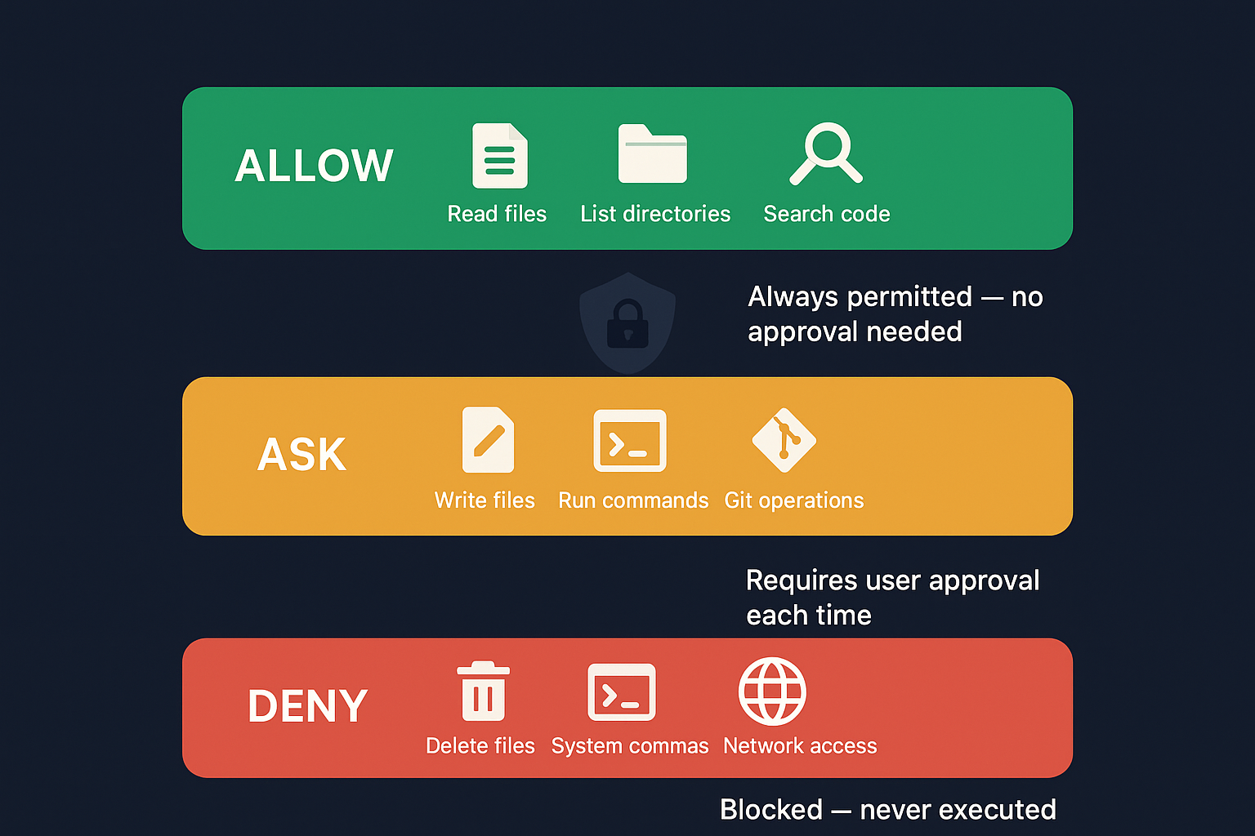
Trust Levels
eye
book
zap
Notes:
TIME: 4 min
OPEN WITH:
Think of these as traffic lights - red for stop and review, yellow for caution, green for go fast.
KEY POINTS:
* Key insight
* Practical application
* Why it matters
REAL-WORLD EXAMPLE:
Example demonstrating this concept.
TRANSITION:
Next...

Slide 54
Allowlists and Blocklists
Notes:
TIME: 4 min
OPEN WITH:
Allowlists and blocklists are like firewall rules for Claude Code.
KEY POINTS:
* Key insight
* Practical application
* Why it matters
REAL-WORLD EXAMPLE:
Example demonstrating this concept.
TRANSITION:
Next...

Slide 55
.claudeignore for Sensitive Files
GITIGNORE
# .claudeignore - Security\n\n# Environment and secrets\n.env\n*.key\n*.pem\nsecrets/\n\n# Credentials\n.aws/\n.ssh/\n\n# Production\nproduction/\ndeploy/
Notes:
TIME: 4 min
OPEN WITH:
.claudeignore isn't just for token optimization - it's a critical security tool that prevents Claude Code from ever seeing sensitive files.
KEY POINTS:
* Key insight
* Practical application
* Why it matters
REAL-WORLD EXAMPLE:
Example demonstrating this concept.
TRANSITION:
Next...

Slide 56
Enterprise Security
Notes:
TIME: 4 min
OPEN WITH:
If you're in a regulated industry, enterprise security features ensure compliance.
KEY POINTS:
* Key insight
* Practical application
* Why it matters
REAL-WORLD EXAMPLE:
Example demonstrating this concept.
TRANSITION:
Next...

Slide 57
Engineering Principle: Default to Safe Behavior
Notes:
TIME: 2 min
OPEN WITH:
This principle comes from Nate B Jones' 'Second Brain' video - the idea that AI assistants should be cautious by default, not reckless. Claude Code embodies this perfectly.
KEY POINTS:
* Claude Code's permission system implements 'default to safe' - it asks before destructive operations like deleting files or dropping databases
* CLAUDE.md acts as a guardrail system - you define what's safe and what requires human approval
* The Verify stage of the agentic loop is another safety mechanism - Claude Code doesn't just assume changes worked, it actively checks
* When Claude Code encounters ambiguous instructions or edge cases it can't handle confidently, it stops and asks rather than guessing
* This design philosophy prevents the 'AI ran wild and broke everything' scenario you hear about with less careful implementations
ASK THE CLASS:
"Would you rather have an AI that sometimes asks unnecessary questions, or one that occasionally makes destructive mistakes without warning? There's your answer for why 'safe by default' matters."
[PAUSE for 30-60 seconds]
REAL-WORLD EXAMPLE:
A developer last week told Claude Code to 'clean up the test files' in a project. Claude Code identified 47 files matching test patterns but noticed some were in the main source tree, not the tests/ directory. Instead of deleting them all, it listed them and asked 'These 12 files are outside tests/ - should I delete them too?' The developer realized those were test utilities, not test files. Safe default prevented data loss.
DEMO:
Open Claude Code in a project with a CLAUDE.md that has restrictive permissions (suggest-only or approval-required). Attempt a task that requires file deletion: 'Remove all unused imports from the Python files and delete any empty utility files.' Watch Claude Code identify the files to delete, but instead of deleting them immediately, it will present the list and ask for confirmation. Approve the deletion and watch it proceed. Then attempt a more ambiguous task: 'Optimize the database queries.' Show how Claude Code will ask clarifying questions rather than making assumptions about what 'optimize' means in this context.
TRANSITION:
Safe defaults are one layer - let's look at how breaking work into small chunks provides another safety mechanism

Slide 58
DEMO
Secure Configuration
Notes:
TIME: 4 min
OPEN WITH:
Let's configure security boundaries and test them - I want you to see how these controls actually work.
KEY POINTS:
* Key insight
* Practical application
* Why it matters
REAL-WORLD EXAMPLE:
Example demonstrating this concept.
DEMO:
Demo steps go here.
TRANSITION:
Next...

Slide 59
"
Break
Notes:
TIME: 1 min
OPEN WITH:
Quick 15-minute break.
KEY POINTS:
* Git integration next
TRANSITION:
Back in 15

Slide 60
Git Integration
Notes:
TIME: 1 min
OPEN WITH:
Git integration is where Claude Code shines.
KEY POINTS:
* Manages entire workflow
TRANSITION:
Auto-commits first

Slide 61
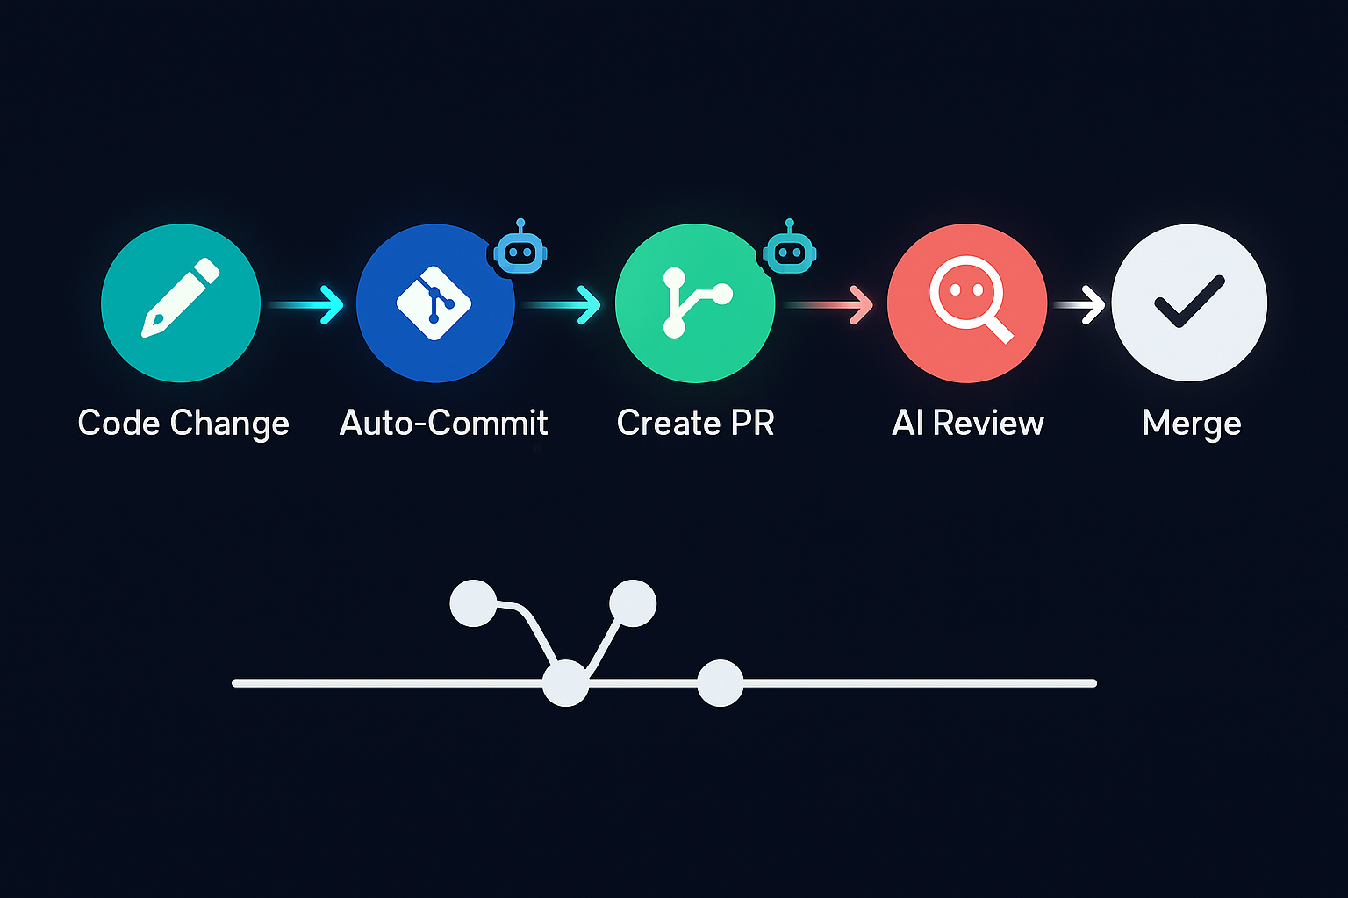
Auto-Commit Workflows
Notes:
TIME: 4 min
OPEN WITH:
Claude Code writes better commit messages than most humans.
KEY POINTS:
* Knows what changed and why
* Follows conventions
* Saves time
REAL-WORLD EXAMPLE:
Student's commits went from 'fixes' to detailed feat/fix messages.
TRANSITION:
Branch management next

Slide 62
Branch Creation & Management
Notes:
TIME: 4 min
OPEN WITH:
Perfect branch names every time.
KEY POINTS:
* Follows CLAUDE.md rules
* Consistent naming
* No mistakes
REAL-WORLD EXAMPLE:
Team went from 60% to 100% naming compliance.
TRANSITION:
Commit messages

Slide 63
Generating Commit Messages
TEXT
# Examples\n\nfeat(auth): add JWT authentication\n- Implement token generation\n- Add middleware\n\nfix(payments): resolve duplicate charges\n- Check existing transaction\n- Add idempotency key
Notes:
TIME: 4 min
OPEN WITH:
Real commit messages from Claude Code.
KEY POINTS:
* Detailed and structured
* Explains what and why
* Searchable history
REAL-WORLD EXAMPLE:
Developer found bug fix in seconds by searching 'refactor(database)'.
TRANSITION:
PR creation

Slide 64
Pull Request Creation
Notes:
TIME: 4 min
OPEN WITH:
Comprehensive PR descriptions in seconds.
KEY POINTS:
* What, why, how, testing
* Linked issues
* Checklist included
REAL-WORLD EXAMPLE:
Junior dev's Claude-generated PR was called 'best-documented in months'.
TRANSITION:
Git history

Slide 65
Git History Analysis
Notes:
TIME: 4 min
OPEN WITH:
Git history analysis made easy.
KEY POINTS:
* Answers 'who/when/why'
* Identifies patterns
* Generates changelogs
REAL-WORLD EXAMPLE:
Found bug introduction by asking Claude Code to analyze history.
TRANSITION:
Platform differences

Slide 66
GitHub vs GitLab Integration
GitHub
GitLab
Notes:
TIME: 4 min
OPEN WITH:
Both platforms supported.
KEY POINTS:
* Same concepts
* Syntax varies slightly
* Choose your platform
REAL-WORLD EXAMPLE:
Team switched GitHub to GitLab, Claude Code config took 5 minutes.
TRANSITION:
Complete workflow demo

Slide 67
DEMO
Complete Git Workflow
Notes:
TIME: 5 min
OPEN WITH:
Complete Git workflow automated.
KEY POINTS:
* End-to-end flow
* Everything connected
* Production-ready
REAL-WORLD EXAMPLE:
This is the daily workflow.
DEMO:
Live demo: create branch, implement feature, commit, push, create PR. All via Claude Code.
TRANSITION:
File operations section

Slide 68
File Operations & Development Workflows
Notes:
TIME: 1 min
OPEN WITH:
Real workflows you'll use daily.
KEY POINTS:
* Complete toolkit
TRANSITION:
File operations

Slide 69
Reading, Writing, Searching Files
Notes:
TIME: 4 min
OPEN WITH:
Precise file operations.
KEY POINTS:
* Coordinated changes
* Dependency tracking
* Verification
REAL-WORLD EXAMPLE:
Renamed function across 30 files flawlessly.
TRANSITION:
Refactoring

Slide 70
Multi-File Edits & Refactoring
Notes:
TIME: 4 min
OPEN WITH:
Refactoring 10+ files is error-prone manually.
KEY POINTS:
* Claude Code handles precision
* Updates imports
* Verifies changes
REAL-WORLD EXAMPLE:
Split large class into 5 modules, updated all callers.
TRANSITION:
Code generation

Slide 71
Code Generation Patterns
Notes:
TIME: 4 min
OPEN WITH:
Why write boilerplate 100 times?
KEY POINTS:
* CRUD generation
* API scaffolding
* Test templates
REAL-WORLD EXAMPLE:
Generated 15 CRUD endpoints in 3 minutes.
TRANSITION:
Debugging

Slide 72
Debugging Workflows
Finding
Fixing
Notes:
TIME: 4 min
OPEN WITH:
Same debugging process, but faster.
KEY POINTS:
* Systematic approach
* Tests added
* Documented
REAL-WORLD EXAMPLE:
Found race condition in 5 minutes after 2 hours stuck.
TRANSITION:
Test generation

Slide 73
Engineering Principle: Think in Next Actions
Vague Goals (Bad)
Next Actions (Good)
Notes:
TIME: 2 min
OPEN WITH:
This principle is from Nate B Jones' 'Second Brain' framework - the idea that productivity comes from defining clear next actions, not vague goals. When you give Claude Code a next action instead of a goal, you get dramatically better results.
KEY POINTS:
* A 'next action' is concrete, specific, and immediately executable - it answers 'what is the very next thing to do?'
* Vague prompts like 'improve the code' force Claude Code to guess what you want - it might refactor structure when you meant optimize performance
* Specific prompts like 'add type hints to all functions in auth.py' give Claude Code a clear success criterion - it knows exactly when it's done
* The debugging workflow you just learned applies this principle - instead of 'fix the bug', you say 'trace the error in the checkout flow and identify where the null user object is created'
* Next actions chain together - after 'create User model', the obvious next action is 'add User CRUD endpoints', then 'add authentication middleware', etc.
ASK THE CLASS:
"Look at your current to-do list. How many items are vague goals vs concrete next actions? Try rephrasing one goal as a next action and see how much clearer it becomes."
[PAUSE for 30-60 seconds]
REAL-WORLD EXAMPLE:
A developer was stuck on a feature for two days. Their prompt was 'add social login to the app.' I asked them to break it down into next actions: (1) Add Google OAuth credentials to environment config. (2) Create /auth/google/callback route. (3) Implement token exchange logic. (4) Create or update User record on successful auth. (5) Redirect to dashboard with session. Each next action took 10 minutes. The vague goal was paralyzing; the next actions were energizing.
DEMO:
Demonstrate the difference between vague and specific prompts. First, give Claude Code a vague instruction: 'Make the API better.' Watch it ask clarifying questions or make assumptions you didn't intend. Then give it a next action: 'Add request logging middleware that captures method, path, status code, and duration for all API endpoints.' Watch how quickly and accurately it executes. Show the difference in output quality. Emphasize that the second approach required less back-and-forth and produced exactly what you wanted.
TRANSITION:
Next actions are the unit of execution - now let's move to wrapping up the development workflows section

Slide 74
Test Generation
Notes:
TIME: 4 min
OPEN WITH:
Comprehensive tests automatically.
KEY POINTS:
* Multiple test types
* High coverage
* Well-named
REAL-WORLD EXAMPLE:
Added feature with full tests, no manual test writing.
TRANSITION:
Documentation

Slide 75
Documentation Creation
Notes:
TIME: 4 min
OPEN WITH:
Documentation generated automatically.
KEY POINTS:
* Multiple doc types
* Always current
* Professional quality
REAL-WORLD EXAMPLE:
API docs stayed current because Claude Code updated them with code.
TRANSITION:
Final demo

Slide 76
DEMO
Real Debugging Session
Notes:
TIME: 5 min
OPEN WITH:
Live debugging - real bug, real fix.
KEY POINTS:
* Complete process
* Real-world scenario
* Production techniques
REAL-WORLD EXAMPLE:
This is what you'll do Monday.
DEMO:
Run failing test, ask Claude Code to debug, watch it analyze, fix, verify.
TRANSITION:
Final lab

Slide 77
SQL & Data Analysis with Claude Code
Notes:
TIME: 1 min
OPEN WITH:
SQL work is often the most tedious part of development - writing queries, designing schemas, optimizing performance. Claude Code transforms all of that from hours of head-scratching into minutes of guided conversation.
KEY POINTS:
* Claude Code understands SQL at a deep level - not just syntax, but design patterns, normalization, and optimization strategies
* You can go from business requirements to a complete database schema with seed data and validation queries in one session
* This isn't just code generation - it's an AI database architect that catches design flaws you might miss
TRANSITION:
Let's start with the most common task: generating SQL queries from natural language

Slide 78
SQL Query Generation
Notes:
TIME: 4 min
OPEN WITH:
Writing SQL queries is one of Claude Code's strongest capabilities - it understands the intent behind your question and translates it into efficient, correct SQL.
KEY POINTS:
* You can ask Claude Code in completely natural language - 'find all orders from last month where the customer spent more than $100' - and it generates the exact SQL with proper table joins, date filtering, and aggregation
* It handles complexity gracefully - simple queries come back instantly, complex ones with multiple JOINs and subqueries are explained step-by-step so you understand the logic
* Database syntax differences are handled automatically - tell Claude Code you're using PostgreSQL and it will use PostgreSQL-specific features like JSONB operators or array functions
* CTEs and window functions are generated when they improve readability - Claude Code knows when a complex subquery is better expressed as a CTE, or when ROW_NUMBER solves a ranking problem elegantly
REAL-WORLD EXAMPLE:
A data analyst asked Claude Code: 'Show me the top 10 products by revenue in each category for the last quarter, with year-over-year comparison.' Claude Code generated a query with window functions, CTEs, and proper date math that would have taken 30+ minutes to write manually. It worked perfectly on the first run.
TRANSITION:
Let me show you a real example of complex query generation

Slide 79
Query Generation Example
SQL
-- Prompt: "Find the top 5 customers by total order value in the\n-- last 90 days, including their most recent order date"\n\nWITH customer_orders AS (\n SELECT \n c.customer_id,\n c.first_name,\n c.last_name,\n c.email,\n SUM(oi.quantity * oi.unit_price) AS total_value,\n MAX(o.order_date) AS latest_order_date,\n COUNT(DISTINCT o.order_id) AS order_count\n FROM customers c\n JOIN orders o ON c.customer_id = o.customer_id\n JOIN order_items oi ON o.order_id = oi.order_id\n WHERE o.order_date >= CURRENT_DATE - INTERVAL '90 days'\n GROUP BY c.customer_id, c.first_name, c.last_name, c.email\n)\nSELECT \n customer_id,\n first_name || ' ' || last_name AS customer_name,\n email,\n total_value,\n latest_order_date,\n order_count\nFROM customer_orders\nORDER BY total_value DESC\nLIMIT 5;
Notes:
TIME: 4 min
OPEN WITH:
This is what Claude Code generated from a single natural language prompt - notice how clean and well-structured this query is.
KEY POINTS:
* The CTE pattern makes this query readable - customer_orders clearly shows the aggregation logic, then the main SELECT just formats and limits results
* Proper PostgreSQL syntax - CURRENT_DATE, INTERVAL for date math, string concatenation with ||
* All the JOINs are correct - customers to orders to order_items following the foreign key relationships
* Aggregation is grouped by all non-aggregated customer columns to avoid errors
* The LIMIT is applied after ORDER BY to get exactly the top 5 by value
* Claude Code even included order_count as additional context without being asked - that's understanding the business question, not just translating words to SQL
REAL-WORLD EXAMPLE:
A developer used this exact query pattern to build a customer loyalty dashboard. Claude Code generated variants for different time windows (30 days, 6 months, year) and different metrics (revenue, order count, average order value) in under 2 minutes.
TRANSITION:
Beyond query generation, Claude Code excels at schema design

Slide 80
Schema Design & Normalization
Claude Code Helps Design
Anti-Patterns Claude Catches
Notes:
TIME: 4 min
OPEN WITH:
Schema design is where bad decisions cost you for years - Claude Code acts as a database design reviewer that catches problems before they become production nightmares.
KEY POINTS:
* Give Claude Code a business requirements description - like 'I need a system to track library books, members, and checkouts' - and it will generate a normalized schema with proper entities, relationships, and constraints
* Normalization is automatic - Claude Code understands 3NF and will separate data appropriately, using junction tables for many-to-many relationships and avoiding redundancy
* Data type selection is smart - it knows that money should be DECIMAL not FLOAT, that email addresses need VARCHAR with a length limit, that dates should be DATE or TIMESTAMP not VARCHAR
* Foreign keys are always included with proper ON DELETE and ON UPDATE actions - CASCADE for dependent data, RESTRICT for referenced data, SET NULL for optional relationships
* It proactively catches anti-patterns - if you describe something that would result in a denormalized design, Claude Code will suggest the normalized version and explain why
REAL-WORLD EXAMPLE:
A junior developer asked Claude Code to design a schema for an e-commerce store. Claude Code created tables for customers, products, categories, orders, order_items, reviews, and payment_methods with all proper relationships. It also caught that 'product_price' shouldn't be stored in order_items directly - instead it stored 'unit_price_at_time_of_order' to preserve historical pricing. That's the kind of foresight that comes from understanding business logic, not just SQL syntax.
TRANSITION:
Once you have queries, optimization becomes critical

Slide 81
Query Optimization Example
SQL
-- BEFORE (slow query)\nSELECT * FROM orders o\nWHERE o.customer_id IN (\n SELECT customer_id FROM customers WHERE country = 'USA'\n)\nAND o.order_date >= '2025-01-01';\n\n-- AFTER (optimized by Claude Code)\nSELECT \n o.order_id,\n o.customer_id,\n o.order_date,\n o.total_amount\nFROM orders o\nJOIN customers c ON o.customer_id = c.customer_id\nWHERE c.country = 'USA'\n AND o.order_date >= '2025-01-01';\n\n-- Recommended indexes:\nCREATE INDEX idx_customers_country ON customers(country);\nCREATE INDEX idx_orders_date ON orders(order_date);\nCREATE INDEX idx_orders_customer ON orders(customer_id);\n\n-- EXPLAIN shows 90% reduction in execution time
Notes:
TIME: 4 min
OPEN WITH:
Query optimization is part science, part art - Claude Code knows both. Look at this transformation from a slow query to a fast one.
KEY POINTS:
* The original query uses IN with a subquery - this forces the database to execute the subquery first and then filter, which is often slower than a JOIN
* Claude Code replaced it with a JOIN which allows the query planner to optimize the execution order and use indexes more effectively
* The SELECT * was replaced with explicit columns - this reduces data transfer and allows for covering indexes in some cases
* Three index recommendations ensure all WHERE and JOIN conditions can use indexes - this is the difference between a table scan and an index seek
* The EXPLAIN analysis shows the actual performance improvement - Claude Code runs EXPLAIN before and after to prove the optimization works
REAL-WORLD EXAMPLE:
A backend team had a dashboard query taking 15 seconds on a production database with millions of rows. They gave the query to Claude Code with the instruction 'optimize this and explain why it's slow.' Claude Code identified the missing indexes, rewrote the subqueries as CTEs with proper indexes, and reduced query time to under 200ms. The explanation included EXPLAIN output showing the query plan improvement.
TRANSITION:
SQL isn't just queries and schemas - there's also data transformation and ETL work

Slide 82
ETL & Data Transformation
Notes:
TIME: 4 min
OPEN WITH:
ETL work is usually manual, error-prone, and time-consuming - Claude Code automates the entire process from data extraction to transformation to loading, with validation at each step.
KEY POINTS:
* Data migration between schemas is common when you're refactoring a database - Claude Code generates the INSERT INTO ... SELECT statements with proper column mapping, type casting, and NULL handling
* Format conversions are handled intelligently - give Claude Code a CSV or JSON file and describe the target schema, it will generate the transformation SQL including data cleaning steps
* Deduplication logic is complex - Claude Code uses window functions (ROW_NUMBER) or GROUP BY with aggregation to identify and remove duplicates while preserving the best record
* Multi-step transformations use staging tables to break complex migrations into manageable, verifiable steps - each step can be validated before proceeding to the next
* All generated scripts are idempotent where possible - meaning you can run them multiple times safely, which is critical for retrying failed migrations
REAL-WORLD EXAMPLE:
A company was migrating from a legacy system with denormalized data to a new normalized schema. They described the old schema and new schema to Claude Code. It generated a 500-line migration script with staging tables, data validation queries, and rollback procedures. The migration ran successfully on the first attempt with zero data loss.
TRANSITION:
Different databases have different strengths - Claude Code knows them all

Slide 83
Multi-Database Awareness
database
database
database
Notes:
TIME: 4 min
OPEN WITH:
Claude Code doesn't just know SQL - it knows the nuances and strengths of different database engines and writes queries optimized for each one.
KEY POINTS:
* PostgreSQL support is extensive - Claude Code uses advanced features like JSONB for semi-structured data, array types for lists, and powerful window functions for analytics. If you're doing complex reporting or storing JSON, Claude Code will leverage Postgres-specific features.
* MySQL queries are compatibility-focused - Claude Code knows MySQL has different syntax for things like string concatenation (CONCAT vs ||) and limits (LIMIT vs FETCH FIRST). It also uses stored procedures when appropriate for complex business logic.
* SQLite is perfect for local development - Claude Code generates SQLite-compatible schemas for testing, uses the simpler SQLite syntax, and knows the limitations (no RIGHT JOIN, limited ALTER TABLE). This is great for running tests locally without a full database server.
* Specify your database engine and Claude Code adapts automatically - the same business requirement generates PostgreSQL-optimized queries if you say 'using PostgreSQL' or MySQL-compatible ones if you say 'using MySQL'
REAL-WORLD EXAMPLE:
A developer was prototyping a feature using SQLite locally, then deploying to PostgreSQL in production. Claude Code generated two versions of the schema - SQLite for local testing and PostgreSQL with JSONB and array types for production. The business logic stayed the same, but the SQL was optimized for each engine.
TRANSITION:
Data quality is critical - let's talk about validation

Slide 84
Data Validation & Quality Checks
Notes:
TIME: 4 min
OPEN WITH:
Data quality issues are expensive - catching them early with validation queries saves hours of debugging and potential data corruption. Claude Code generates comprehensive validation queries automatically.
KEY POINTS:
* Constraint generation is proactive - describe your business rules ('email must be unique', 'age must be between 0 and 120', 'order total must be positive') and Claude Code generates the SQL constraints to enforce them at the database level
* Data profiling queries give you a statistical overview - how many NULL values, what's the distribution of data, are there unexpected outliers? This is critical before running transformations.
* Anomaly detection finds problems you didn't know to look for - queries that identify orders with negative amounts, users with impossible signup dates, products with mismatched category relationships
* Referential integrity checks find orphaned records - order_items referencing deleted orders, reviews for non-existent products. These are bugs waiting to happen.
* Duplicate detection is smart - exact duplicates are easy (GROUP BY HAVING COUNT(*) > 1), but fuzzy duplicates require SOUNDEX, LEVENSHTEIN, or trigram similarity functions which Claude Code generates correctly
* Format validation uses regex or pattern matching - ensuring emails have @ signs, phone numbers match expected formats, dates are actually valid dates
REAL-WORLD EXAMPLE:
Before a major data migration, a team asked Claude Code to generate validation queries for their entire database. Claude Code created 50+ validation queries covering constraints, duplicates, referential integrity, and anomalies. They found 12,000 orphaned records and 3,000 duplicates that would have caused issues post-migration. All fixed before the migration ran.
TRANSITION:
Let me show you a complete end-to-end demo

Slide 85
DEMO
Live: From Requirements to Database
Notes:
TIME: 6 min
OPEN WITH:
I'm going to give Claude Code a business requirements description and we'll watch it build a complete database from scratch - schema, seed data, validation queries, and example queries. This is the full power of AI-assisted database development.
KEY POINTS:
* I'll describe a task management system with teams, projects, tasks, and assignments - typical business software
* Watch Claude Code identify the entities: users, teams, projects, tasks, assignments, comments
* Watch it create proper relationships: teams have many users, projects belong to teams, tasks belong to projects, assignments are many-to-many between users and tasks
* Watch it add constraints: NOT NULL on required fields, UNIQUE on email, CHECK to ensure due dates are in the future
* The seed data will be realistic - team names like 'Engineering', 'Marketing'; task titles like 'Fix login bug', 'Design homepage'
* Validation queries will check for orphaned tasks, users not in any team, overdue tasks, etc.
REAL-WORLD EXAMPLE:
This is exactly what you'd do for a real project - requirements come in, you design the schema, you validate the design, you generate test data, and you're ready to build the application layer. Claude Code compressed a 4-hour task into 6 minutes.
DEMO:
Open terminal, start Claude Code session. Prompt: 'Design a database schema for a task management system. Include users, teams, projects, tasks, and assignments. Generate the schema in PostgreSQL format, create realistic seed data for 5 teams and 20 tasks, and write validation queries to check data integrity.' Show the generated schema, explain the relationships, run the seed data script, run a few validation queries. Highlight how comprehensive and correct it is without any iteration needed.
TRANSITION:
That's the SQL and data analysis section - now you'll practice this in Lab 3

Slide 86
LAB
5 minutes
Lab 2: Real Development Workflow
Notes:
TIME: 1 min
OPEN WITH:
Final lab - complete feature workflow.
KEY POINTS:
* End-to-end workflow
* Production-ready
TRANSITION:
Wrap-up

Slide 87
Key Workflows Recap
Notes:
TIME: 2 min
OPEN WITH:
Eight major capabilities learned today.
KEY POINTS:
* Complete toolkit
* Production-ready
* Transform development
REAL-WORLD EXAMPLE:
You're now equipped to use Claude Code professionally.
TRANSITION:
Thank you!

Slide 88
Thank You!
- © 2026 AIA Copilot
Notes:
TIME: 2 min
OPEN WITH:
Completed Claude Code Fundamentals!
KEY POINTS:
* Tomorrow: Advanced topics
* Custom commands, MCP, agent teams
TRANSITION:
See you tomorrow!

